Slide 1
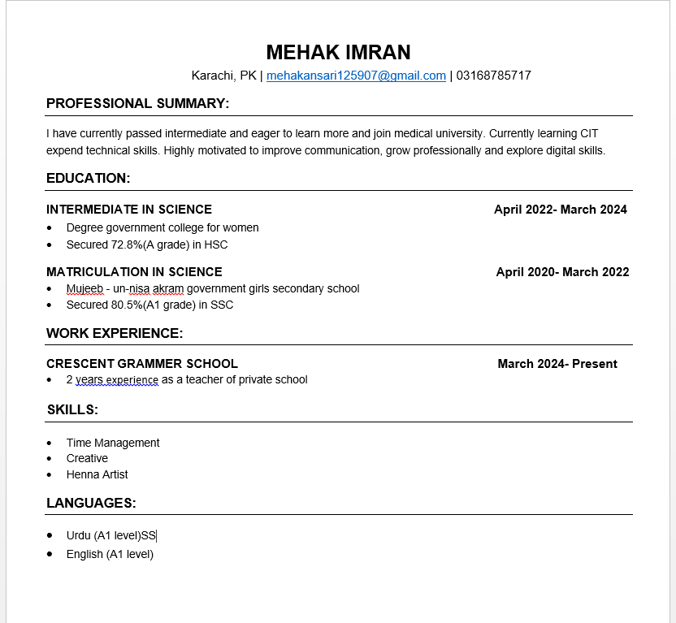
RESUME DOCUMENT:
Header: name , city , phone number , email.
Summary: 2lines about your goals
Education: degree , institute , college year
Skills: list of key skills
Work experience: job \ internship , teaching

Slide 2
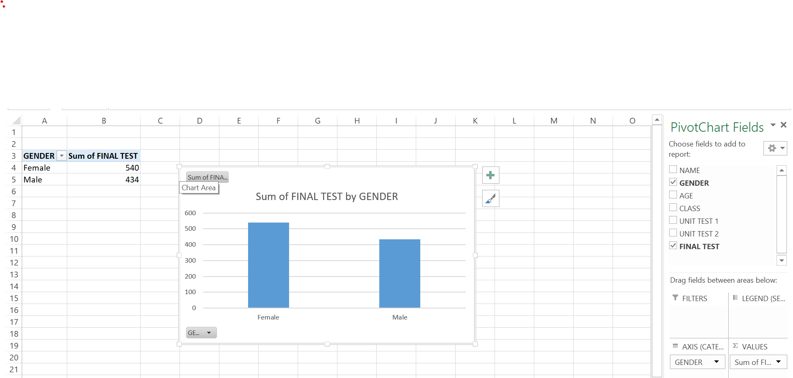
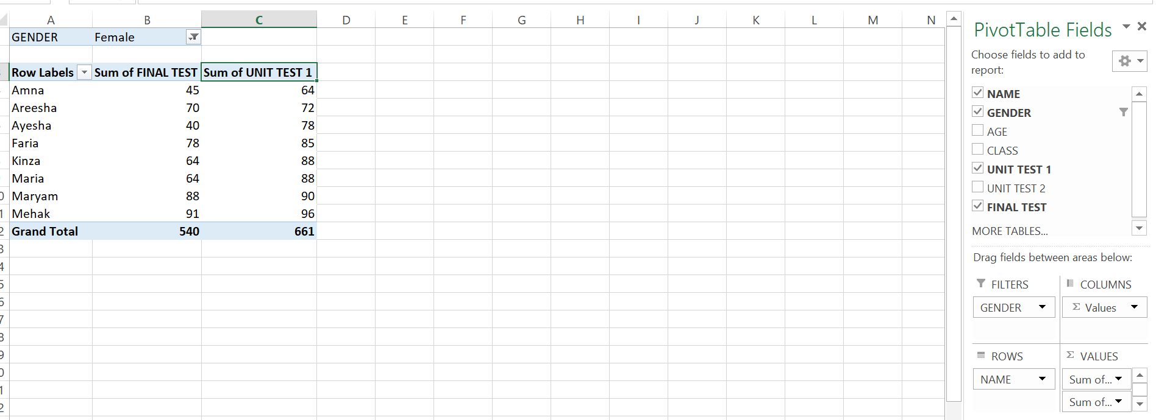
PIVOT TABLE:
Enter data: insert .........> pivot table
Rows: categories
Columns : vertical , direct compare
Filter: filter data
“A pivot table is an excel tool that summarizes large data into totals , averages , and
comparisons in a simple report” ……………

Slide 3
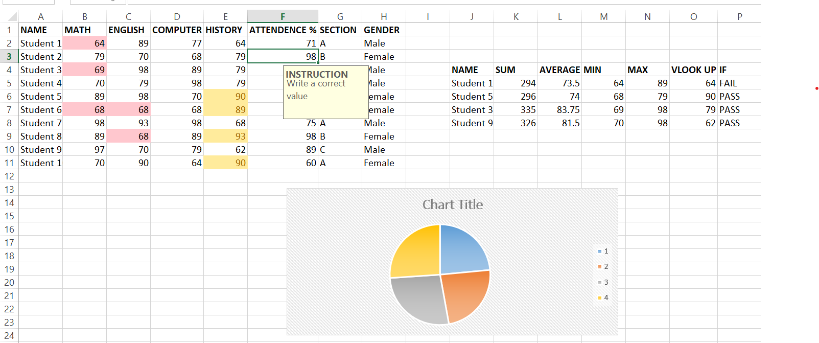
SPREAD SHEET :
A spread sheet is a digital sheet made up of rows and columns used to organize , calculate , and analyze data :
Cell
Programs
Work
Formulas
Charts
Used
Data validation:
apply …. select cell
control data ( drop down )
data validation …> set rules (number, date list)
Used …>make drop downs , restricts wrong , entries stop
Conditional formatting :
Conditional formatting automatically changes cell color or style
Based on the cells value…( color below red and yellow )
Calculation:
Sum….> total marks of each student
Average…> average marks
Min…> minimum marks
Max…> highest marks
V Look up…> use to quickly find specific student data
If…> if check condition and gives works
“Able to use data validation in excel for accurate data entry”

Slide 4
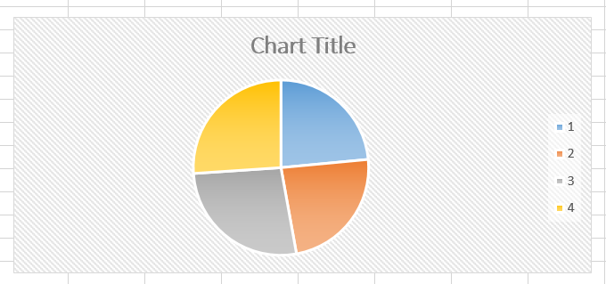
HOW TO USE EXCEL IN CHART:
Enter data
Select data
Go to insert
Choose chart types (line , pie , column )
Edit titles (colors or labels)

Slide 5
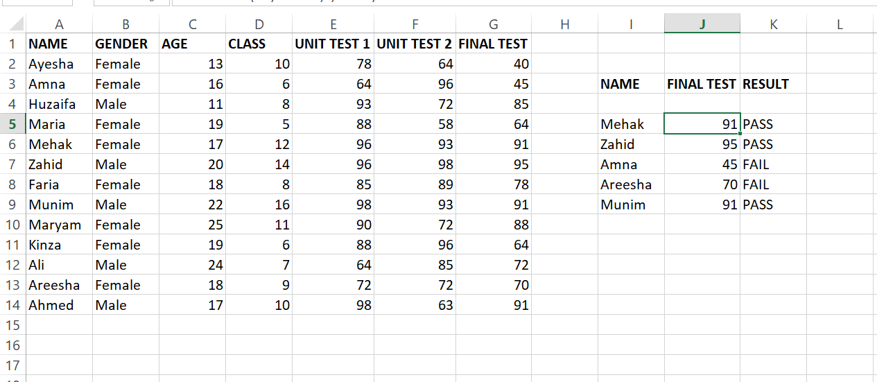
STUDENT RECORD:
What is it? A student record table contains detail like name , age , section , gender , attendance
roll number and test records.
Why important? Keeps results organized, easy to track performance , compare students, and check pass / fail
How made? Enter data in excel……>and columns for test ….> use formulas ……>(Sum , Average , Min, Max ,If , V look up
A student record works to store , track , and organize student information.

